Slide 1
JCS2201-PYTHON PROGRAMMING
FUNCTIONS
Prepared by
M.Maria jeraldin sindhia, AP/CSE

Slide 2
FUNCTIONS
DEFINITION: A function is a block of organized code that can be executed multiple times from different parts of program. Two main advantages of functions: Modularity → They help us to divide our program into multiple tasks. For each task we can define a function. This makes the code modular. Code reusability → Functions provide a reuse mechanism. The same function can be called any no. of times.

Slide 3
ADVANTAGES OF FUNCTIONS
Modularity-breakdown of large pgm to smaller modules
Code reusability-reduce duplication
Code readability-easy to understand
Coding efficiency-minimize use of resources
Saves time

Slide 4
TYPES OF PYTHON FUNCTIONS:
Python Built-in Functions
Python User-defined Functions
Python Recursion Functions
Python Lambda Functions

Slide 5
Python Built-in Functions
Built-in functions are the pre-defined function in Python that allows using the basic properties of string and numbers in program.
There are 60+ built-in functions in Python. Eg. abs(), chr(), print(), input(), int(), dict(), float(), len().

Slide 6
Python User-defined Functions
User Defined Functions are the functions defined by user according to his requirement to perform specific task.
They must be defined in the program before using.
Function definition should start with a keyword ‘def’.

Slide 7
Python Recursion Functions
A recursive function is a function that calls itself using self- referential expressions. This means that the function will continue to call itself and repeat its behavior until some condition is met to return a result.

Slide 8
Python Lambda Functions
Python Lambda Functions are anonymous functions,
means that the function is without a name

Slide 9
1. Python Built-in Functions
Also termed as pre-defined functions. The Python interpreter has a number of functions that are always available for use. These functions are called built-in functions. Eg. print() → a function used to print the given object to the standard output device (screen) or to the text stream file. In Python 3.6, there are 68 built-in functions
9

Slide 10
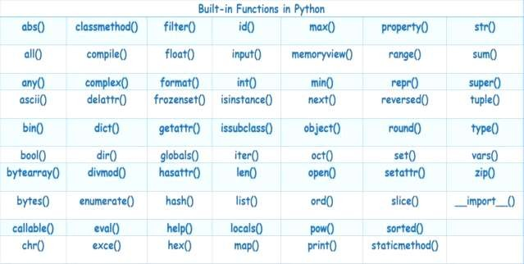

Slide 11
2. Python User-defined Functions
Functions that we define ourselves to do the certain specific task are referred to as user-defined functions. User-defined functions defined using the keyword ‘def’ followed by function name and parameters If we use functions written by other users in the form of the library, it can be termed as library functions. All the other functions that we write on our own fall under user- defined functions. So, our user-defined function could be a library function to someone else. A program can have any number of user-defined functions.

Slide 12
2. Python User-defined Functions
Advantages of user-defined functions Modularity - User-defined functions help to decompose a large program into small segments which makes the program easy to understand, maintain and debug. Code reusability - If repeated code occurs in a program. The function can be used to include those codes and execute when needed by calling that function. Coding efficiency - Programmers working on a large project can divide the workload by making different functions.

Slide 13
Syntax:
def function_name(argument1, argument2, ...) :
statement_1
statement_2
....
Example:
def add(x, y):
sum = x + y
return sum

Slide 14
Rules to define a function
Use the def keyword with the function name to define a function.
Function header must end with colon ( : )
Pass the number of parameters as per the requirement.(Optional).
Define the function body with a block of code. The action to be performed is given here.
Finally function will have return a value. (Optional)

Slide 15
ACTUAL AND FORMAL PARAMETERS
def add_numbers(a, b)://function definition
sum_result = a + b
print("Sum is:", sum_result)
# Function call with actual parameters: 10 and 5
add_numbers(10, 5)// function call
a and b are formal parameters – they are placeholders defined in the function header.
10 and 5 are actual parameters – real values passed into the function when it's called.

Slide 16
TYPES OF ARGUMENTS IN PYTHON
Depending on the way of passing parameters to a function, the different types of arguments used in Python are
Default arguments
Keyword arguments
Positional arguments
Arbitrary arguments

Slide 17
TYPES OF ARGUMENTS --Default arguments
Python Program arguments can have default values.
We assign a default value to an argument using the assignment operator in python(=).
When we call a function without a value for an argument, its default value (as mentioned) is used.
Example 1: def square(x = 20): sq = x * x return sq
print(“Answer1 = “, square()) print(“Answer2 = “, square(5))
OUTPUT: Answer1 = 400
Answer2 = 25

Slide 18
Keyword arguments
  With keyword arguments in python, the order of passing the arguments can be changed without any consequences.
Example:
def divide(a, b): quotient = a / b return quotient
print(“ANSWER1 = “, divide(100, 20))
print(“ANSWER2 = “, divide(b=30, a=1800))
OUTPUT: ANSWER1 = 5.0
ANSWER2 = 60.0

Slide 19




POSITIONAL ARGUMENTS
Example:
def add(x, y):
sum = x + y
return sum
a, b = 10, 20
ans = sum(a, b)
print(“Sum = “, ans)
The positional arguments are the most basic type of arguments passed to a function.
When a function is called and values are provided for its parameters, those values are assigned to the parameters based on their position or order in the function's parameter list.
For example, a is assigned to x and b is assigned to y.

Slide 20
Arbitrary Arguments
Example: def add(*num): sum = 0 for n in num: sum += n
return sum
ans = add(10, 20, 30, 40) print(“Sum = “, ans)
We may not always know how many arguments we’ll get.
In that case, we use an asterisk(*)before an argument name.
Arbitrary arguments are used when it is not sure about the number of arguments to be passed to the function.
OUTPUT:
Sum = 100

Slide 21
SCOPE OF VARIABLES
All variables in a program may not be accessible at all locations in that program.
This depends on where we have declared a variable.
The scope of a variable determines the portion of the program where it can be accessed.
There are two basic scopes of variables in Python-
  Global scope
  Local scope

Slide 22
Global Scope of Variables
Variables defined outside a function body have a global scope.
They can be accessed throughout the program body by all functions from any part of the program.
Such variables are called as global variables.
Local Scope of Variables
Variables defined inside a function body have a local scope.
They can be accessed only inside the function in which they are declared.
Such variables are called as local variables.

Slide 23
x = 10 # Global variable
def my_function():
x = 5 # Local variable (only exists inside this function)
print("Inside function, x =", x)
my_function()
print("Outside function, x =", x)

Slide 24
3. RECURSION FUNCTIONS
A recursive function is a function that calls itself using self- referential expressions. This means that the function will continue to call itself and repeat its behavior until some condition is met to return a result. If a function is defined as f(x), then the recursive function will also have an f of something such as f(x - 1) or f(x/a).

Slide 25
Example 1:
‘’’ Python program to find the factorial of a number using recursive function ‘’’
def calc_factorial(x):
if x == 1:
return 1
else:
  return (x * calc_factorial(x-1))
num = 4
f = calc_factorial(num)
print(f"The factorial of {num} = {f}“)
OUTPUT:
The factorial of 4 = 24

Slide 26
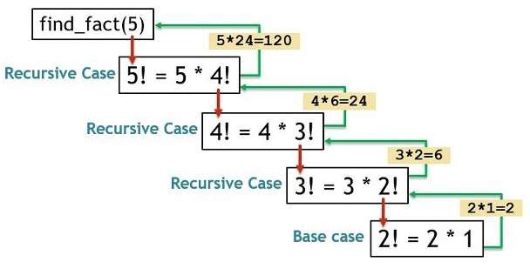

Slide 27
3. RECURSION FUNCTIONS
Example 2: ‘’’ Python program that checks whether a string is a palindrome or not using recursive function ‘’’ def pal_check(s): if len(s) <= 1: return True elif s[0] == s[-1]: return pal_check(s[1:-1]) else: return False |  | str = input("Enter a string: ") result = pal_check(str.lower()) if result: print(f“{str} is a palindrome.") else: print(f“{str} is not a palindrome.")
 | OUTPUT: Enter a string: Madam Madam is a palindrome

Slide 28
Advantages of Recursion
Recursive functions make the code look clean and elegant.
A complex task can be broken down into simpler sub-problems
using recursion.
Sequence generation is easier with recursion than using some nested iteration.
Disadvantages of Recursion
Sometimes the logic behind recursion is hard to follow through.
Recursive calls are expensive (inefficient) as they take up a lot of memory and time.
Recursive functions are hard to debug.

Slide 29
4. LAMBDA FUNCTIONS
Lambda functions are similar to user-defined functions but without a name, referred to as anonymous functions. They are small, single-expression functions that are defined without a name using the lambda keyword. Lambda functions can have any number of arguments but only one expression. The expression is evaluated and returned. Lambda functions can be used wherever function objects are required.

Slide 30
Syntax:
lambda arguments : expression
Example 1:
sq = lambda x : x * x
print(sq(6))

Slide 31
DATE AND TIME METHODS
 | Example: to get current time and date import datetime print(datetime.datetime.now()) print(datetime.date.today())
 |  |  | OUTPUT: 2024-04-17 11:12:45.617120 2024-04-17

Slide 32
Commonly used classes in the ‘datetime’ module:
  date class– Manipulate just date ( Month, day, year)
  time class – Time independent of the day (Hour, minute, second, microsecond)
  datetime class – Combination of time and date (Month,
day, year, hour, minute, second, microsecond)
  timedelta class — A duration of time used for manipulating dates (like difference between two date, time, or datetime instances to microsecond resolution)

Slide 33
Example :
from datetime import date
date1 = date(2000, 11, 2) # to create a date object
today = date.today() # to get today’s date
print(date1)
print(today)
OUTPUT:
2000-11-02
2025-04-25

Slide 34
#The month, date and year can be separated.
#A date can be converted into a string.
Example :
from datetime import date today = date.today()
d1 = today.strftime("%m/%d/%y")
print(d1)
d2 = today.strftime("%b-%d-%Y")
print(d2)
d3 = today.strftime("%d/%m/%Y")
print(d3)
d4 = today.strftime("%B %d, %Y")
print(d4)
OUTPUT: 04/22/24 Apr-22-2024 22/04/2024
April 22, 2024

Slide 35
DATE AND TIME METHODS – time Class
datetime.time() module is used to work with time. A time object generated from the time class represents the local time. Components: hour minute second microsecond tzinfo

Slide 36
datetime.strftime() method helps to convert date and time into string.
datetime.strptime() method helps to convert a date in string format into date formats.

Slide 37
calendar module
The calendar module gives a wide range of methods to play with yearly and monthly calendars. Here, we print a calendar for a given month
import calendar cal = calendar.month(2020, 4) | OUTPUT:
print ("Here is the calendar:") | Here is the calendar: April 2020 Mo Tu We Th Fr Sa Su
print (cal) | 1 2 3 4 5
print (cal) | 6 7 8 9 10 11 12 13 14 15 16 17 18 19
 | 20 21 22 23 24 25 26
 | 27 28 29 30

Slide 38
Modules
Definition: A module in Python is a single file that contains Python code in the form of functions, executable statements, variables, and classes.
A module can be written in Python itself.
Eg. datetime, math, Random

Slide 39
calc.py.
def add(x,y):
return x + y
def sub(x, y):
return x - y
def prod(x, y):
return x * y
def div(x, y):
return x / y

Slide 40
USE A MODULE
import calc
a = 10 b = 20
sum = calc.add(a,b) print(sum)
Use the import keyword to incorporate the module into a program.
Example: Using the module calc module for a program ‘main.py’

Slide 41
Use the import keyword to
incorporate the module into a program Use keyword ‘as’ to create an alias
name for a module.
import calc as c
a = 10 b = 20
sum = c.add(a,b) print(sum)

Slide 42
from calc import *
a = 10
b = 20
sum = add(a,b)
print(sum)

Slide 43
dir() function
dir() function returns a sorted list of strings containing the names defined in a module.
The list contains the names of all the variables, functions, classes, etc.

Slide 44
PACKAGE
Definition: A package is a collection of modules organized in a directory. Packages allow us to group multiple related modules together under a common namespace, making it easier to organize and structure our code base.
The package is a simple directory having collections of modules.

Slide 45
Create a Directory
Add module
Include __init__.py file
Subpackages can be created

Slide 46
def greet(name):
print(f"Hello, {name}!")
def invite(name):
print(f“WELCOME, {name}!")
__init__.py
from package1 import mod1, mod2
mod1.greet(“Jaden")
mod2.invite(“Smith”)

